Slide 1

The discounted cash flow (DCF) model
Unit 3
BU7313 Financial Modelling & Scenario Analysis
Prof Gerhard Kling University of Aberdeen

Slide 2
AGENDA: Unit 3
The theory of DCF
Free cash flows
The ‘pizza theory’ of corporate finance
Continuing value
Forecasting free cash flows
Growth predictions
Ratios and ROIC
Expected debt
Value drivers
ROIC trees
Types of growth
Another look at Kellogg
Value driver analysis
DCF model

Slide 3
Contents
The theory of DCF
Forecasting free cash flows
Value drivers
Another look at Kellogg

Slide 4
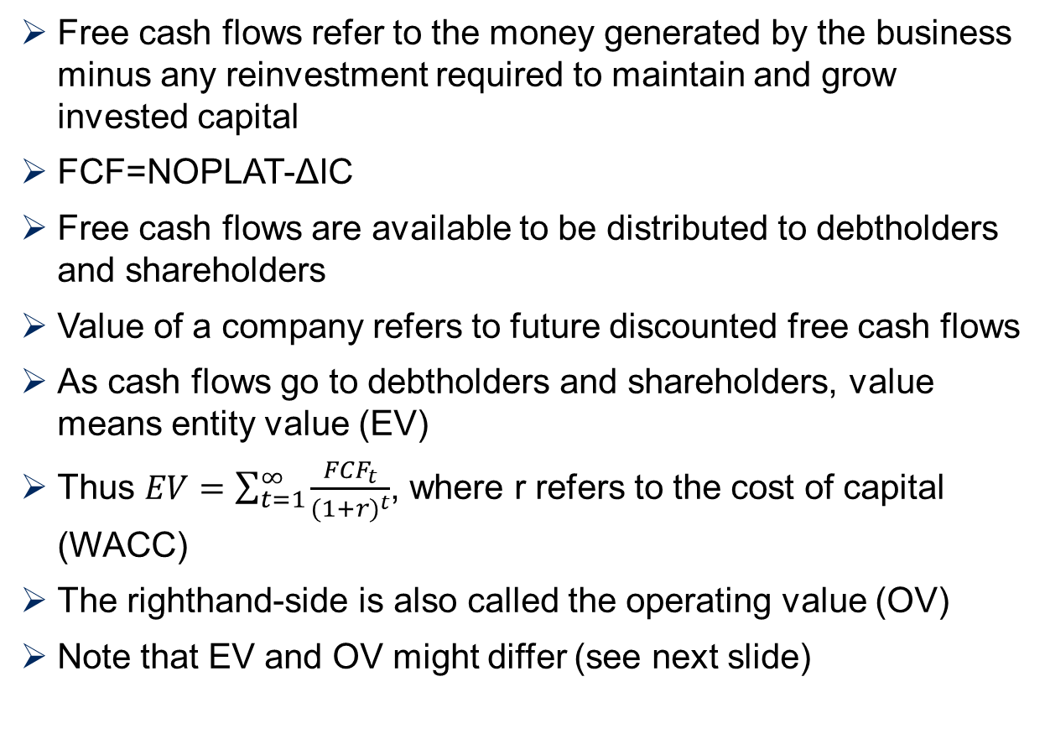
Free cash flows and their distribution
Free cash flows refer to the money generated by the business minus any reinvestment required to maintain and grow invested capital
FCF=NOPLAT-ΔIC
Free cash flows are available to be distributed to debtholders and shareholders
Value of a company refers to future discounted free cash flows
As cash flows go to debtholders and shareholders, value means entity value (EV)
Thus $EV=\sum_{t=1}^{∞}{\frac{{FCF}_{t}}{{(1+r)}^{t}}}$, where r refers to the cost of capital (WACC)
The righthand-side is also called the operating value (OV)
Note that EV and OV might differ (see next slide)

Slide 5
Deriving equity value from operating value (DCF)
860
Example
50
60
40
500
0
70
30
1,500
1,650
1,050
Operating value
Excess Cash
Investment such as non-consolidated subsidiary
Other non-operating assets
- for example, asset from discontinued operation (idle factory)
Total enterprise value
Debt
Stock Options
Pension
Preferred Equity
Common equity
value

Slide 6
Difference between operating and entity value
Excess cash
Excess cash = Cash & cash equivalents - Operating cash
Cash not needed to run the business
Focus on day-to-day funding (short-term funding)
Non-consolidated subsidiaries
If company holds less than 50% of equity of another company, subsidiary is not consolidated
Other non-operating assets
Discontinued operations
Unused land

Slide 7
From entity value to common equity value
Debt
Take debt reported on balance sheet
Liability to debtholders
Stock options (see next lecture)
Value stock options (Black-Scholes equation)
Promise to executives
Pension liabilities
Promise to employees
Important if payments are guaranteed (defined benefit plans) and assets are insufficient to cover expected future liabilities (see next lecture)
Preferred equity
Treated like debt
No voting rights

Slide 8
Pay-out profiles of shareholders and debtholders
Debtholders
Contractual payment (interest)
Repayment of principal at maturity
In case of default, loss can occur (recovery)
Risk-aversion due to pay-out profile as they do not benefit from upside
Shareholders
Residual claim
Linear pay-out profile

Slide 9
Continuing value
Company can potentially exist until infinity
Value of free cash flow diminishes rapidly due to discounting
However, the continuing or terminal value should be considered
Forecasting stops after 15-20 years due to a lack of data but also as the value of discounted cash flows becomes very small
Assumptions for long-term growth and profitability
Long-term growth (nominal) at most equal to nominal GDP growth
Profitability (ROIC) tends to be more stable and needs to be in excess of cost of capital (COC) thus ROIC>COC

Slide 10
The continuing value formula
Recall from last lecture that FCF=NOPLAT×(1-IR), where IR is the investment rate
Then g=ROIC×IR and hence IR=g/ROIC
Thus FCF=NOPLAT×(1- g/ROIC)
Let’s consider that the explicit forecasting period ends at time T
FCF_{T+1}=NOPLAT_{T+1}×(1- g/ROIC) assuming growth and ROIC remain constant
What is the value of these future FCF from T+1 to infinity at time T?
FCF_{T+2}=NOPLAT_{T+1}×(1- g/ROIC) ×(1+g)
FCF in T+2 needs to be discounted by 1/(1+r)²
Let’s consider M=β+ β²+… where β=(1+g)/(1+r)

Slide 11
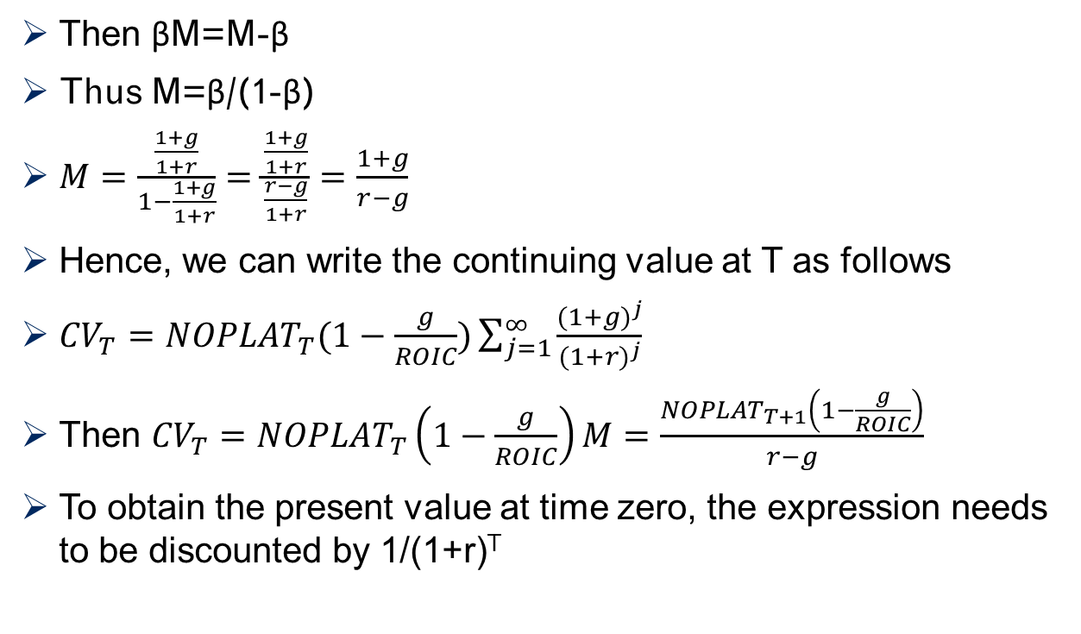
Deriving the continuing value formula
Then βM=M-β
Thus M=β/(1-β)
$M=\frac{\frac{1+g}{1+r}}{1−\frac{1+g}{1+r}}=\frac{\frac{1+g}{1+r}}{\frac{r−g}{1+r}}=\frac{1+g}{r−g}$
Hence, we can write the continuing value at T as follows
${CV}_{T}={NOPLAT}_{T}(1−\frac{g}{ROIC})\sum_{j=1}^{∞}{\frac{{(1+g)}^{j}}{{(1+r)}^{j}}}$
Then ${CV}_{T}={NOPLAT}_{T}\left(1−\frac{g}{ROIC}\right)M=\frac{{NOPLAT}_{T+1}\left(1−\frac{g}{ROIC}\right)}{r−g}$
To obtain the present value at time zero, the expression needs to be discounted by 1/(1+r)^{T}

Slide 12
Mid-year and monthly adjustments
Our discounting approach overstates the value of time as all cash flows are assumed to flow at the end of the discrete time period
A mid-year adjustment assumes that cash flows occur steadily during a year
Hence, we multiply the factor (1+r)^{0.5} to our valuation
Another issue is to consider the current month for a valuation model
Example: in September 2019 we want to value cash flows that occur from January 2020 to December 2020. We can do the mid-year adjustment to ensure that cash flows occur during the whole year 2020. However, whether we do the valuation in September 2019 or later matters as well
Thus discount to Jan 2019 then multiply (1+r)^{9/12}

Slide 13
Contents
The theory of DCF
Forecasting free cash flows
Value drivers
Another look at Kellogg

Slide 14
How to forecast cash flows?
Forecast revenues (which is easier) and then derive cash flows based on assumptions
Revenue forecasts depend on the market (mature market, developed country, demand, luxury product) and the state of the company (age, current size, expansion possibilities)
A small company in a mature market can grow by increasing the number of stores or products
However, adding more stores has natural limits, and you should expect that growth rates go down to a normal level
In the long run, a company cannot grow faster than nominal GDP otherwise it would dominate the world

Slide 15
Forecasting free cash flows
The most used approach is to forecast revenues and based on ratios derive free cash flows
Benefits
Easier to forecast revenues with two drivers: (1) market growth (macroeconomic and demographic trends), (2) increase in market share (depends on competitive advantage, not unlimited)
Useful in established industries with stable ROIC and limited growth
Disadvantages
Does not permit a link between growth and ROIC, e.g. positive externalities or network effects (see high-growth companies)
Too simplistic as ROIC might be cyclical or technological changes might affect business models

Slide 16
Use ratios (assumptions) to link cash flows to revenues
(1) Forecast revenues based on expected growth rates (explicit forecasting period based on analysts’ forecasts followed by about 15 years midterm forecasting period and the terminal value)
(2) Link costs to revenues by assuming constant cost/revenue ratios (based on historical data – use average)
(3) Determine NOPLAT based on revenue and cost forecasts by applying the statutory tax rate (usually around 35%)
(4) Link invested capital to revenues by assuming constant revenue/IC ratios (turnover)
(5) Goodwill and minority interest are assumed to be constant
(6) Use total debt to balance total assets and total liabilities
(7) Determine interest expenses by debt in previous period times implied interest rate
(8) Determine adjusted net income = NOPLAT – interest expense*(1-tax rate) and consider tax shield of interest expense
(9) Model change in total equity (retained earnings) as previous equity plus current net income (money which goes to shareholders – does not matter whether you assume dividends or accumulation of equity)

Slide 17
Forecasting periods
Short-term forecasts (next three years) are often based on analysts’ reports (consensus forecasts)
Mid-term forecasts (another 10-15 years) are based on assumptions and global trends
Global trends include
Demographic transition
Population aging
Historical analysis is needed to establish likely scenarios which is usually based on three to five years
If industry exhibits cycles (e.g. steel), then longer periods are needed

Slide 18
Kellogg’s growth forecast: No growth scenario
Growth has been limited and is expected to remain low
After a modest growth period in the short-term, growth remains flat

Slide 19
Predicting debt
Debt is needed to balance the balance sheet; thus, D=IC+Goodwill-Equity-Minority interest
Goodwill and minority interest are usually assumed to remain constant
Equity increases with net income, where Net Income=NOPLAT-Interest expense(1-tax rate)
We will discuss tax shields later
Check whether predicted debt is sustainable (more later) using financial leverage and interest coverage

Slide 20
Kellogg’s predicted debt will go into cash holding
Negative debt expected (cash holding) due to low growth and high ROIC

Slide 21
Contents
The theory of DCF
Forecasting free cash flows
Value drivers
Another look at Kellogg

Slide 22
Value drivers: growth and ROIC
We can express free cash flows in terms of growth and ROIC, i.e. two value drivers can explain firms’ value
Usually we assume that growth and ROIC are independent (not correlated) which is often a good approximation (see Kellogg’s case)
However, if economies of scale are at play, growth does affect costs
Economies of scale emerge if costs can be written as a fixed cost component (F) and variable costs that change with output X
Example: Costs=F+aX with a>0
Then average costs refer to Costs/X=F/X+a
Hence, higher output permits distributing fixed costs lowering average costs

Slide 23
Growth and ROIC are the two value drivers
Value
Growth
ROIC
Different ways to grow
Organic growth
M&A
Market entry
Exchange rate effect
ROIC has to exceed WACC

Slide 24
The right combination matters
 |  | Growth
 |  | 3% | 4% | 5% | 6% |  | 7%
ROIC | 10% | 471 | 439 | 400 | 355 |  | 302
 | 15% | 823 | 838 | 860 | 895 |  | 958
 | 20% | 1180 | 1251 | 1347 | 1487 |  | 1717
 | 25% | 1539 | 1668 | 1843 | 2100 |  | 2518
 | 30% | 1899 | 2088 | 2345 | 2723 |  | 3339
 | 35% | 2260 | 2509 | 2851 | 3352 |  | 4172
 | 40% | 2621 | 2932 | 3357 | 3984 |  | 5012
 | 45% | 2983 | 3355 | 3866 | 4619 |  | 5858
 | 50% | 3345 | 3778 | 4375 | 5256 |  | 6706

Slide 25
ROIC trees are a useful tool to analyse profitability
ROIC
NOPLAT
Revenues
Costs
COGS
SG&A
Taxes
IC
NET PP&E
Working capital

Slide 26
Understanding good and bad growth
Revenue growth figures might look impressive / but growth does not mean value creation
It is essential that profitability (ROIC) exceeds cost of capital (WACC) otherwise more growth will burn more money
How to detect good and bad growth strategies?
Look at simple ratios like revenues per employee or revenues per store etc.
Ratios tell you something about the efficiency (growth can be driven by efficiency gains or by adding more stores)
Adding more store (points of sale) might increase revenues – but might reduce profitability and increase maintenance costs in future

Slide 27


Growth might be affected by M&A and currency effects
Revenue growth 2003
As reported
Net
M&A
Currency
Organic
As reported
Net
M&A
Currency
Organic

Slide 28
Contents
The theory of DCF
Forecasting free cash flows
Value drivers
Another look at Kellogg

Slide 29
What does the market think about Kellogg?
With very low growth assumptions, we can derive a fundamental share price of USD 69.9 which is close to the current share price (on 22nd August 2019) of USD 63.4
How do we know whether our assumptions are reasonable?
Best to switch perspectives, the market values Kellogg as if ROIC remains constant with growth close to zero
Is this a plausible assumption?
Will profit margin remain high?
What is your recommendation?

Slide 30
MAIN INSIGHTS
The theory of DCF
Operating value versus entity value
Deriving the value of equity
Forecasting of cash flows
Revenue based with constant ratios
Limitations of this approach (e.g. high-growth firms)
Value drivers
ROIC trees
Types of growth
Using DCF models to understand the market’s perspective

